Slide 1
Model Hierarchy
Partial Latent Class
Hierarchical prior
Quadratic Exponential Model with Sparse Correlation

Slide 2
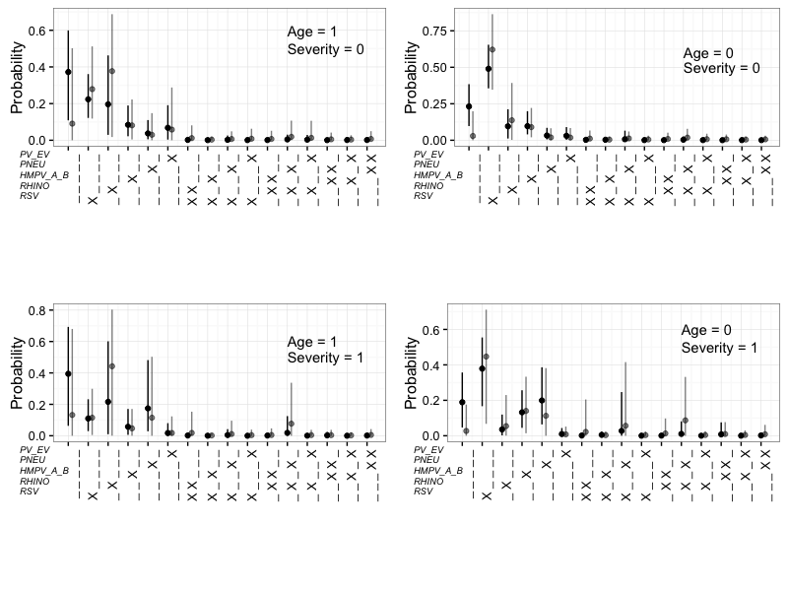
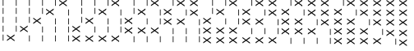
Latent Variable
Regular Quadratic Exponential Model:
=
Sparse Correlation:
Hierarchical Prior:
I_{j} ~ Bernoulli(p)
p ~ Beta(a, b)

Slide 3
Simulation Study
5 candidate etiological pathogens.
BS are available for each of them.
500 cases and 1000 controls in each data set.
200 independent data sets simulated.
Two binary covariates: age and severity.
Simulation I-a:
Allow multiple pathogen infect lung at the same time. Pr(2 or more) ≈ 0.35
All pathogens have SS measurements.
Relatively low-quality data:
SS TPR ≈ 0.1 BS TPR ≈ 0.6 BS FPR ≈ 0.45
Simulation I-b:
Only pathogen D, E have SS measurements.
Simulation II:
Relatively high-quality data:
SS TPR ≈ 0.8 BS TPR ≈ 0.9 BS FPR ≈ 0.05
Simulation III:
Only single-pathogen infection is possible.

Slide 4
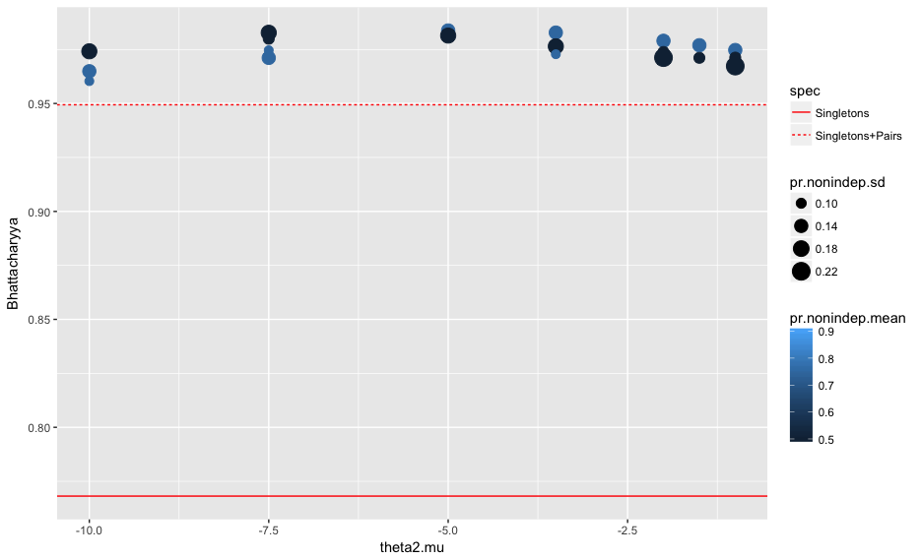
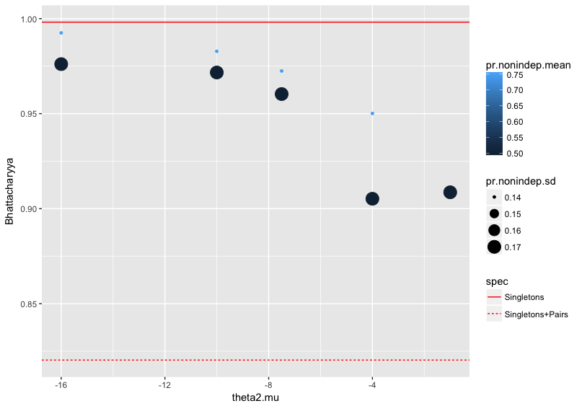
Simulation I and III vs. pLCM

Slide 5
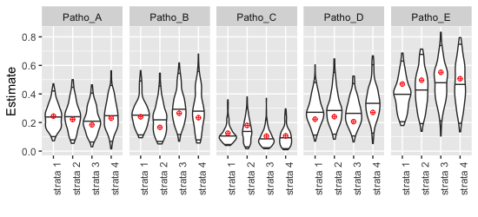
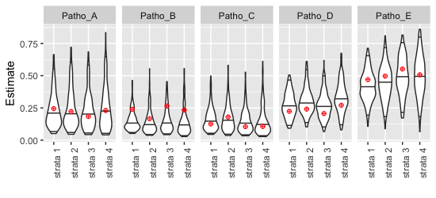
Simulation I-a vs. I-b
SS available for all five pathogens:
SS available for pathogen D and E only:
≈

Slide 6
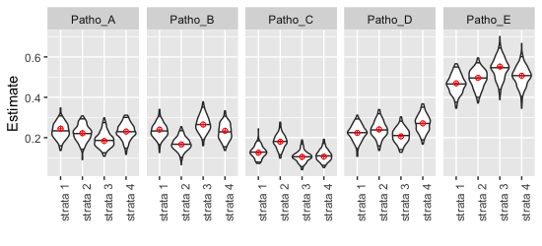
Simulation I-a vs. II
Low-quality data:
High-quality data:
≈

Slide 7
Appendix
β₀ 0.210 -0.282 -0.835 -0.205 1.068
β_{age} -0.1 -0.5 0.5 0.2 0.1
β_{sev} -0.3 0.2 -0.2 -0.1 0.3
β_{a:s} 0.4 0.3 -0.4 0.2 -0.2
Θ₂ = (-1.5, -1.5, -1.5, -1.5, 0.0, 0.0, -1.5, -1.5, -1.5, -1.5)
Mu [1] [2] [3] [4] [5]
00 0.245 0.240 0.126 0.224 0.469
10 0.222 0.166 0.180 0.241 0.497
01 0.184 0.265 0.105 0.206 0.552
11 0.230 0.234 0.106 0.271 0.507
Pr(s) [0] [1] [2] [3] [4] [5]
00 0.090 0.550 0.329 0.031 0.000 0
10 0.085 0.555 0.328 0.031 0.000 0
01 0.081 0.558 0.329 0.032 0.000 0
11 0.076 0.536 0.351 0.036 0.001 0

